Slide 1
Bioelectronics, Medical Imaging and Our Bodies dourse overview
Maryse de la Giroday
6-week course
SFU Liberal Arts & Adults 55+ program

Slide 2
6-week outline
Week 1: Can the Blind Really See? The Future of Prosthetics
Week 2: Who Owns Medical Implant Data and/or Wearable Technology Data?
Week 3: X-Rays and CT Scans: Useful but Carcinogenic? + Monitoring Devices

Slide 3
6-week outline
Week 4: Peering into the Brain: Functional MRI and Neuroimaging
Week 5: Reverse Engineering the Brain and Neuromorphic Engineering
Week 6: Growing Human Organs

Slide 4
Certificate students
For each course, you'll complete a short, typed, double-spaced essay of four to six pages (1,000–1,500 words). Rather than an overview of what the course covered, your essay should be a thoughtful and personal response to one or both of the following questions:
How did this course contribute to your appreciation and knowledge of the subject?
How, and in what way, did this course change your way of thinking?
(http://www.sfu.ca/continuing-studies/programs/seniors-certificate-liberal-arts/program-structure.html)

Slide 5
Machine/flesh (1 of 2 [eyes])
Deus Ex: Human Revolution, a role-playing shooter (game) extrapolates MicroTransponder, prosthetics, robotics, and other current augmentation technology into a vision of how technologically enhanced people might gain superhuman abilities and at what cost. (EIDOS – Montreal-based company)

Slide 6
Machine/flesh (2 of 2 [eyes])
EyeBorg; A one eyed film maker (Canadian Rob Spence) and an unemployed engineer, have embedded a video camera and a transmitter in a prosthetic eye. That eye went into Rob’s eye socket, and recorded the world from a perspective that’s never been seen before.

Slide 7
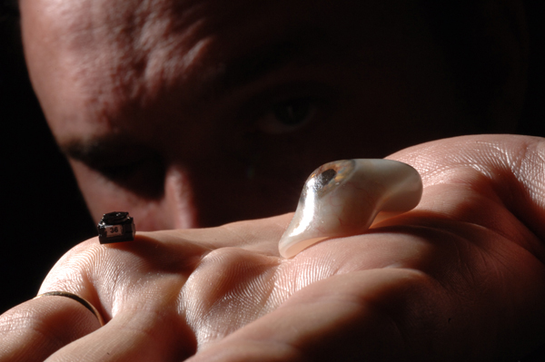
EyeBorg; the camera/eye

Slide 8
Eyeborg video
<iframe width="560" height="315" src="//www.youtube.com/embed/TW78wbN-WuU?rel=0" frameborder="0" allowfullscreen></iframe>
http://eyeborgproject.com/
https://www.youtube.com/watch?v=TW78wbN-WuU#t=108

Slide 9
Artificial retina projects (1 of 2)
We can rebuild you (http://cordis.europa.eu/fet-house/themes/theme/2 ... features Grégoire Cosendai in Nov. 2010 TEDxVienna)
Israeli start-up: Nano Retina (http://www.nano-retina.com/) “Nano Retina, Inc. is developing an ultra small, easy to implant, artificial retina designed to restore sight.” (2011)

Slide 10
Artificial retina projects (2 of 2)
US Food and Drug Administraton (FDA) approved the first commercial artificial retina (Feb. 2013) … the first bionic eye to be approved for patients in the US called the Argus® II Retinal Prosthesis System, it transmits images from a small, eye-glass-mounted camera wirelessly to a microelectrode array implanted on a patient’s damaged retina. The array sends electrical signals via the optic nerve, and the brain interprets a visual image. (http://www.frogheart.ca/?p=9229)

Slide 11
Artificial retina: Physicists develop an interface to the optical nerve
Aug. 7, 2014 http://www.frogheart.ca/?p=14350 (Graphene flagship and The Human Brain)
“optical prostheses for blind people whose optical nerves are still intact. The implants convert incident light into electrical impulses that are transmitted to the brain via the optical nerve. There, the information is transformed into images. Although various approaches for implants exist today, the devices are often rejected by the body and the signals transmitted to the brain are generally not optimal.” graphene has excellent biocompatiblilty

Slide 12
Tracheas & other parts
Pig trachea 2008
Synthetic trachea 2011
Alexander Seifalian/Paolo Macchiarini (2008 & 2011; http://www.frogheart.ca/?p=4078)
Follow-up Dec. 27, 2013 (http://www.frogheart.ca/?p=12027)
Bioengineered ear at Cornell (http://www.frogheart.ca/?p=9310)
Printing bone in Washington state (http://www.frogheart.ca/?p=5275)

Slide 13
Alfred North Whitehead
No absolute gap between living and nonliving (Process and reality, 1929)

Slide 14
Machine/flesh [equipment]
(Mar. 6, 2013 news item on ScienceDaily)
“People with spinal cord injuries show strong association of wheelchairs as part of their body, not extension of immobile limbs.
The human brain can learn to treat relevant prosthetics as a substitute for a non-working body part, according to research published March 6 in the open access journal PLOS ONE …”

Slide 15
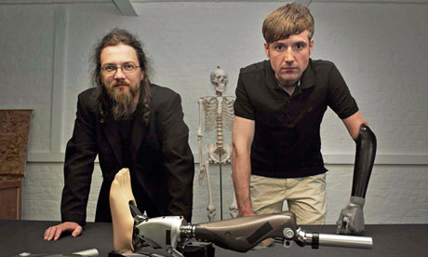
DIY bionics 2013

Slide 16
Dr. Bertolt Meyer
researcher from Zurich University & lifelong user of prosthetic technology
How to build a bionic man (BBC 4 broadcast in Feb. 2013)
iLimb Ultra, (Bertolt is a user), is part of a new class of myoelectric prosthetics, the custom-made devices function by placing electrical sensors directly in contact with the skin. These sensors pick up the signals generated by muscular movements in the residual limb – signals that are then translated by software into natural, intuitive movement in the prosthetic limb.

Slide 17
Growing into your prosthetics
Medical breakthrough: known as Intraosseous Transcutaneous Amputation Prosthesis (ITAP), it uses a layer of porous and bioactive (hydroxyapatite-coated) surfaces that encourage adhesion by living tissues. This living “seal” prevents bacterial infections, thereby allowing surgeons to provide amputees with securely-attached limbs that carry weight in a natural way. (http://www.frogheart.ca/?p=3964)

Slide 18
RoboLaw (1 of 2)
The Economist article, You, robot (September 1st – 7th, 2012 issue re: EU’s RoboLaw Project),
Hugh Herr, a roboticist at the Massachusetts Institute of Technology, described disabilities as conditions that persist “because of poor technology” and made the bold claim that during the 21st century disability would be largely eliminated.

Slide 19
RoboLaw (2 of 2)
What gave his words added force was that half way through his speech, after ten minutes of strolling around the stage, he unexpectedly pulled up his trouser legs to reveal his bionic legs, and then danced a little jig. In future, he suggested, people might choose to replace an arthritic, painful limb with a fully functional robotic one. “Why wouldn’t you replace it?” he asked. “We’re going to see a lot of unusual situations like that.”

Slide 20
Above human (1 of 2)
Paul Hochman for Fast Company, Bionic Legs, iLimbs, and Other Super-Human Prostheses delves further into the world where people may be willing to trade a healthy limb for a prosthetic. (2010)

Slide 21
Above human (2 of 2)
… an emblem of hurt and loss has become a paradigm of the sleek, modern, and powerful. … Michael Bailey, a 24-year-old student in Duluth, Georgia, is looking forward to the day when he can amputate the last two fingers on his left hand.
“I don’t think I would have said this if it had never happened,” says Bailey, referring to the accident that tore off his pinkie, ring, and middle fingers. “But I told Touch Bionics I’d cut the rest of my hand off if I could make all five of my fingers robotic.”

Slide 22
Human enhancement
Future of Your Body Flare magazine article (August 2009) Tracy Picha
Aimee Mullins
Oscar Pistorius

Slide 23
Human enhancement: Europe (1 of 2)
Human enhancement (European Parliament report): pharmaceutical products: neuroimplants that provide replacement sight or other artificial senses, drugs that boost brain power, human germline engineering & existing reproductive technologies, nutritional supplements, new brain stimulation technologies to alleviate suffering and control mood, gene doping in sports, cosmetic surgery, growth hormones for children of short stature, anti-ageing medication, and highly sophisticated prosthetic applications that may provide specialized sensory input or mechanical output.

Slide 24
Human Enhancement: Europe (2 of 2)
All these technologies signal the blurring of boundaries between restorative therapy and interventions that aim to bring about improvements extending beyond such therapy. As most of them stem from the medical realm, they can boost societal tendencies of medicalization when increasingly used to treat non-pathological conditions.

Slide 25
Body hacking
Body hacking: “Technology that was the traditional purview of the medical establishment is migrating into the hands of body hackers, and the medical establishment itself is finding ways to enhance humans, not just cure disease ..” (2007, Communication Chaos Congress)

Slide 26
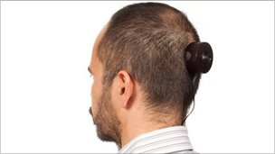
Wafaa Bilal: body hacking/enhancement
An artist who had a camera implanted into the back of his head as a 3rd eye with photos to be taken every minute for one year.
Iraqi-born Wafaa Bilal had surgery last week to remove one of three posts holding the camera in place as it posed a risk of infection. (2011)

Slide 27
Prosthetics aesthetics (1 of 2)
Lanfranco Aceti & his prosthetics project
Aesthetics of prosthetics (Cliff Kuang article for Fast Company)
The prosthetics project (http://design.sva.edu/prosthetics/index.php) at NY School of Visual Arts

Slide 28
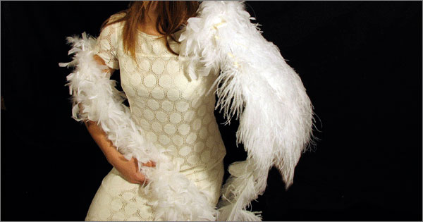
Prosthetic aesthetics (2 of 2)

Slide 29
Canadian thinker
Gregor Wolbring (University of Calgary)
Founded the International Center for Bioethics, Culture and Disability
Exploring discourse surrounding therapeutic enhancement with veterans and soldiers with injuries
http://ucalgary.academia.edu/GregorWolbring

Slide 30
Transhumanism and The Singularity
Ray Kruzweil/Verner Vinge
Transcendence (movie)
Richard Jones (http://www.softmachines.org/wordpress/?p=1549)
Andy Miah (http://www.theguardian.com/profile/andy-miah)

Slide 31
British Tabloid Confuses Deus Ex Company For Real-World Firm
Sarif Industries, the fictional firm at the center of Deus Ex: Human Revolution, has been cited by The Sun as one of the leading innovators in the field of cybernetic implant technology.
http://www.escapistmagazine.com/news/view/128763-British-Tabloid-Confuses-Deus-Ex-Company-For-Real-World-Firm (Andy Chalk, Oct. 16, 2013)

Slide 32
Gateway to Week 2: Data
Eye implant developed at Stanford could lead to better glaucoma treatments (http://news.stanford.edu/news/2014/august/eye-implant-glaucoma-082514.html)
Lowering internal eye pressure is currently the only way to treat glaucoma. A tiny eye implant developed by Stephen Quake's lab could pair with a smartphone to improve the way doctors measure and lower a patient's eye pressure.

