Slide 1
Bioelectronics, Medical Imaging and Our Bodies Week 3: X-Rays and CT Scans: Useful but Carcinogenic? + Monitoring Devices
Maryse de la Giroday
6-week course
SFU Liberal Arts & Adults 55+ program

Slide 2
FrogHeart.ca
Getting there & finding the slide decks & other materials

Slide 3
Week 2: unfinished business
Stephen Friend
Wants to study healthy people
The Resilience Project: The Search For Unexpected Heroes (http://resilienceproject.me/)

Slide 4
Stephen Friend & healthy people
You can donate your DNA to medical research as we search for “healthy” adults who have rare genetic changes that we’d expect to cause severe illness in childhood. We know that these “resilient” people exist, and we believe if we can understand what is protecting them from illness, then we can make advances towards treating or even preventing these diseases. (from the resilience project homepage)

Slide 5
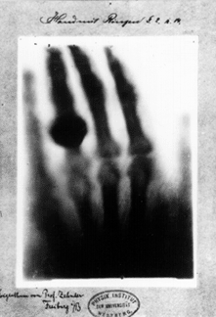
What is this?

Slide 6
Week 3: : X-Rays, CT Scans and monitoring devices
X-rays were first observed and documented in 1895 by Wilhelm Conrad Roentgen, a German scientist who found them quite by accident when experimenting with vacuum tubes.
He took his first X-Ray 1 week later. It was his wife’s hand.

Slide 7
Naming the X-Ray
The photograph electrified the general public and aroused great scientific interest in the new form of radiation. Roentgen called it "X" to indicate it was an unknown type of radiation. The name stuck, although (over Roentgen's objections), many of his colleagues suggested calling them Roentgen rays. They are still occasionally referred to as Roentgen rays in German-speaking countries.

Slide 8
NASA and X-Rays
The Earth's atmosphere is thick enough that virtually no X-rays are able to penetrate from outer space all the way to the Earth's surface. This is good for us but also bad for astronomy - we have to put X-ray telescopes and detectors on satellites! We cannot do X-ray astronomy from the ground.
http://science.hq.nasa.gov/kids/imagers/ems/xrays.html

Slide 9
X-Ray process
Hospital: X-ray sensitive film is put on one side of your body, and X-rays are shot through you.
Dentist, the film is put inside your mouth, on one side of your teeth, and X-rays are shot through your jaw …

Slide 10
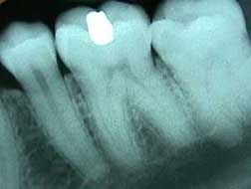
Tooth X-Ray

Slide 11
Why X-Rays are useful?
Because your bones and teeth are dense and absorb more X-rays then your skin does, silhouettes of your bones or teeth are left on the X-ray film while your skin appears transparent. Metal absorbs even more X-rays as per the filling in the image of the tooth

Slide 12
X-Rays and CT (computed tomography)
It’s all radiation:
CT’s (computed tomography)
X-Rays,
Ultrasound (nonionizing radiation),
MRI’s (magnetic resonance imaging; nonionizing radiation)
PET’s (positron emission tomography)

Slide 13
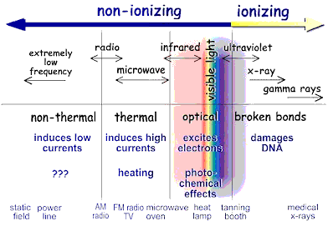
Ionizing and nonionizing radiation

Slide 14
Definitions (1 of 2)
Non-ionizing (or non-ionising) radiation refers to any type of electromagnetic radiation that does not carry enough energy per quantum to ionize atoms or molecules—that is, to completely remove an electron from an atom or molecule.[1] Instead of producing charged ions when passing through matter, the electromagnetic radiation has sufficient energy only for excitation, the movement of an electron to a higher energy state. (Wikipedia)

Slide 15
Definitions (2 of 2)
Ionizing (or ionising) radiation is radiation that carries enough energy to liberate electrons from atoms or molecules, thereby ionizing them. Ionizing radiation comprises subatomic particles, ions or atoms moving at relativistic speeds, and electromagnetic waves on the short wavelength end of the electromagnetic spectrum. … The boundary [between ionizing and nonionizing radiation] is not sharply defined, since different molecules and atoms ionize at different energies. (Wikipedia)

Slide 16
Defining radiation & X-Rays
(physics) the emission of energy as electromagnetic waves or as moving subatomic particles, especially high-energy particles that cause ionization (Google)
Radiant energy from waves or subatomic particles. (radiologyinfo.org)
X-rays are forms of radiant energy, like light or radio waves. Unlike light, x-rays can penetrate the body, which allows a radiologist to produce pictures of internal structures. The radiologist can view these on photographic film or on a TV or computer monitor. (also radiologyinfo.org)

Slide 17
Radiation is everywhere
You can get radiation from:
rocks
other people
Radon gas
uranium mines
Radiation also from some comets, black holes, neutron stars, the sun, and more

Slide 18
Computed Tomography: CTs
Extended set of X-Rays
CT scanner looks like a big, square doughnut
The patient is placed on a slab/moving tabletop
The ‘donut hole’ or opening is 60 cm to 70 cm (24" to 28") in diameter
Inside the covers of the CT scanner is a rotating frame which has an x-ray tube mounted on one side and the banana shaped detector mounted on the opposite side.

Slide 19
Computed Tomography: CTs
A fan beam of x-ray is created as the rotating frame spins the x-ray tube and detector around the patient.
The tube spins around in a slinky-like motion.
Each time the x-ray tube and detector make a 360Â° rotation, an image or "slice" has been acquired.

Slide 20
Computed Tomography (CTs)
During the 360Â° rotation, the detector takes numerous snapshots (called profiles) of the attenuated x-ray beam.
Typically, in one 360Â° lap, about 1,000 profiles are sampled. Each profile is subdivided spatially (divided into partitions) by the detectors and fed into about 700 individual channels.
Each profile is then backwards reconstructed (or "back projected") by a dedicated computer into a two-dimensional image of the "slice" that was scanned.

Slide 21
Computed Tomography (CTs)
http://www.youtube.com/watch?v=tqGmqRrxajQ
The process gives you a 3D image
There are differences in how organs absorb x-rays from any source (e.g., a hollow organ [intestine] absorbs differently than a solid organ [heart])
Lenses to your eyes are especially sensitive

Slide 22
Carcinogenic? (1 of 6)
Dosage/exposure: average person in US is exposed to approximately 3 mSv per year
mSv is one term used to describe exposure
Other terms include: rad or radiation absorbed dose, a gray (Gy), milligray (mGy), rem or roentgen-equivalent-man, millirem, sievert (Sv) (see-vert)
http://www.radiologyinfo.org/en/glossary/glossary1.cfm?gid=369

Slide 23
Carcinogenic? (2 of 6)
Average exposure is due to natural sources: naturally occurring radioactive materials and cosmic radiation from outer space. These natural "background" doses vary throughout the country
e.g. Colorado & New Mexico (People living in the plateaus receive about 1.5 mSv more per year than those living near sea level.)

Slide 24
Carcinogenic? (3 of 6)
The added dose from cosmic rays during a coast-to-coast round trip flight in a commercial airplane is about 0.03 mSv.
Altitude plays a big role, but the largest source of background radiation comes from radon gas in our homes (about 2 mSv per year). Like other sources of background radiation, exposure to radon varies widely from one part of the country to another.

Slide 25
Carcinogenic? (4 of 6)
In simple terms, radiation exposure from one chest x-ray is roughly equivalent to the amount of radiation exposure one experiences from their natural surroundings in 10 days.

Slide 26
Carcinongenic? (5 of 6)
Most models of exposure rates are based on men who are heavier and taller than women and children
Computed Tomography (CT)-Abdomen and Pelvis Exposure: 10 mSv Natural exposure: 3 years Risk of cancer: Low
Computed Tomography (CT)-Abdomen and Pelvis, repeated with and without contrast material 20 mSv 7 years Moderate

Slide 27
Carcinongenic? (6 of 6)
Intraoral X-ray 0.005 mSv 1 day Negligible
Positron Emission Tomography – Computed Tomography (PET/CT) 25 mSv 8 years Moderate
Mammography 0.4 mSv 7 weeks Very Low

Slide 28
What does risk level mean?
Negligible: less than 1 in 1,000,000
Minimal: 1 in 1,000,000 to 1 in 100,000
Very Low: 1 in 100,000 to 1 in 10,000
Low: 1 in 10,000 to 1 in 1000
Moderate: 1 in 1000 to 1 in 500

Slide 29
Risk
Note: These risk levels represent very small additions to the 1 in 5 chance we all have of dying from cancer.
http://www.radiologyinfo.org/en/safety/?pg=sfty_xray
Compare to breast cancer risk stat: 1 in 8 or 9 chance in your lifetime ―poppycock!

Slide 30
Risk of breast cancer by age (1 of 3)
By age 20 1 out of 1,681
By age 30 1 out of 232
By age 40 1 out of 69
By age 50 1 out of 42
By age 60 1 out of 29
By age 70 1 out of 27
Lifetime 1 out of 8

Slide 31
Risk of breast cancer by age (2 of 3)
Source: Among those cancer free at age interval. Based on cases diagnosed 2005-2007. "1 in" are approximates. Source: American Cancer Society Breast Cancer Facts & Figures, 2011-2012.
http://www.imaginis.com/general-information-on-breast-cancer/breast-cancer-statistics-on-incidence-survival-and-screening-2

Slide 32
Risk of breast cancer by age (3 of 3)
The risk of being diagnosed with breast cancer increases with age. In 2013, an estimated 82 percent of new breast cancer cases will occur in Canadian women over the age of 50:
52 percent in women 50 to 69 years of age;
30 percent in women over the age of 69; and
18 percent in women under 50 years of age
http://www.cbcf.org/central/AboutBreastCancerMain/AboutBreastCancer/Pages/BreastCancerinCanada.aspx

Slide 33
Risk of breast cancer
Your risk of breast cancer is defined by your age
It is not possible to assess risk of breast cancer or any cancer over a lifetime.
Those 1 in x over a lifetime risk numbers are wrong, wrong, wrong.

Slide 34
Keeping a history of your X-Rays
f you have had frequent x-ray exams and change healthcare providers, it is a good idea to keep a record of your x-ray history for yourself. … It is also very important to tell your doctor if you are pregnant before having an exam that involves the abdomen or pelvic region.

Slide 35
Amusingly, don’t trust statistics (1 of 2)
A number of studies* linking current or future cancers to previous x-ray imaging studies, especially CT scans. These studies have important limitations in that they lack key data, including : direct radiation exposure measurements for each patient; why the patient underwent the study; and what beneficial information was derived from the CT scan.

Slide 36
Don’t trust statistics (2 of 2)
In addition, underlying statistical models can be fraught with tremendous levels of uncertainty. Nevertheless, these studies are valuable as they highlight the importance of optimizing CT scan techniques and have led to advancements that are resulting in much lower radiation exposures for similar CT studies. (http://www.radiologyinfo.org/en/safety/?pg=sfty_xray

Slide 37
Sources of overexposure (1 of 2)
New England Journal of Medicine, 2004 issue
Medical experts are the most likely culprits for over-exposure
Worst offenders are hospitals
sloppy practices, i.e., not setting the levels properly

Slide 38
Sources of overexposure (2 of 2)
defensive medicine, testing just in case (more common in the US; correlation between law suits and scans)
too lazy to get records from other hospitals or doctors
accidents
In the US, some states require that the exposure level is recorded in the notes
New US federal regulation requiring an alarm being included in the equipment , a safety lock

Slide 39
New medical imaging movement
Imaging wisely
Imaging gently

Slide 40
Less radiation for women over 70 with early breast cancer (1 of 2)
a Yale study found that radiation oncologists are using fewer or less-aggressive radiation procedures on elderly women with early-stage breast cancer.
News release: http://www.eurekalert.org/pub_releases/2014-09/yu-fot091114.php

Slide 41
Less radiation for women over 70 with early breast cancer (2 of 2)
… using a national database of more than 100,000 women treated during the last decade, .. nationally radiation oncologists are less likely to use radiotherapy in women older than 70 with early-stage estrogen-receptor-positive breast cancer and that when they do, treatment is appropriately less-intensive

Slide 42
What about airport scanners?
You’re exposed to more radiation while standing in line at the airport than you do from the airport’s X-ray backscatter scanner
A June 2013 report (measured in nanosieverts) by an independent task force commissioned by the American Association of Physicists in Medicine (AAPM).
http://www.sciencedaily.com/releases/2013/06/130627151642.htm

Slide 43
How many airport scans would be too many?
an individual would have to receive more than 22,500 scans in a year to reach the standard maximum safe yearly dose determined by the American National Standards Institute and the Health Physics Society, according to AAPM Report No. 217, "Radiation Dose from Airport Scanners."

Slide 44
So what is a backscatter X-Ray scanner used in airports? (1 of 7)
First, it’s not the same as the dual-energy transmission X-ray systems screening your carry-on items
Backscatter X-ray machines (sometimes called soft X-ray scanners) are more sophisticated than medical X-ray and dual-energy X-ray systems. Even the machine layout is different.

Slide 45
Backscatter X-Ray scanner (2 of 7)
With traditional X-ray machines, the X-ray tube and imaging sensor sandwich the subject. But with backscatter scanners, the imaging sensor is placed on the same side of your body next to the X-ray tube.
Backscatter X-rays are much weaker than those your doctor employs. These rays don't go through your flesh and bones. Instead, they penetrate your clothing and about an inch into your body, where your tissues scatter and ricochet the rays back toward the sensor.

Slide 46
Backscatter X-Ray scanners (3 of 7)
The sensor records those scattered rays, creating a picture that looks a lot like a naked human body. If that body happens to be surreptitiously carrying a dubious or irregular object, authorities will know
The radiation dose is around 0.02 to 0.03 microsieverts, or about the same as one hour of exposure to natural environmental radiation (called background radiation) Note: manufacturers are secretive about exposure levels (Noordvyk)

Slide 47
Backscatter X-Ray scanners (4 of 7)
Backscatter X-Rays interact differently with different materials
Each different type of material, be it organic or non-organic, causes the X-rays to scatter at different intensity levels, providing a lot of contrast in the resulting two-dimensional image.

Slide 48
Backscatter X-Ray scanners (5 of 7)
f you're a physics buff, there's a more technical way to think about how backscatter X-rays work. As the X-ray collides with atoms in your body, the photons in the X-ray beam scatter. During this process, those photons also push electrons out of some of the atoms, resulting in ions, and sometimes slower moving photons, too - this effect is why X-rays fall into the category of ionizing radiation.

Slide 49
Backscatter X-Ray scanners (6 of 7)
From: http://electronics.howstuffworks.com/gadgets/high-tech-gadgets/backscatter-x-ray.htm
At the time of writing, each backscatter X-Ray unit cost $100,000 US.

Slide 50
Airport scanners (slide show; 7 of 7)
http://www.cbsnews.com/pictures/airport-scanners-and-12-must-know-radiation-risks/

Slide 51
Immune system
There’s a theory and supporting data that a little radiation exposure could be good for you and your immune system.
Courtesy: Allan Noordvyk, Principal researcher, McKesson Medical Imaging
Has spent much of last few years examining patient radiation exposure reduction, tracking, and reduction technologies.
No one knows how much you actually absorb
Models are being developed now

Slide 52
Nuclear power plants: Fukushima (2011)
http://spectrum.ieee.org/energy/nuclear/24-hours-at-fukushima/0
In normal conditions, a nuclear plant employee's radiation limit is 50 millisieverts per year; in an emergency situation it is 100 mSv. The workers had covered about half the distance to the valve when they realized they had to turn back—if they continued, they would exceed the 100 mSv dose. They returned to the control room at 9:30. They had failed.

Slide 53
What was learned before the attempt
the vent crew tried to measure the radiation dose inside the reactor building, which had been off limits for 6 hours. Armed with handheld dosimeters, they opened the air lock, only to find a malevolent white cloud of some "gaseous substance" billowing toward them. Fearing a radiation steam bath, they slammed the door shut.

Slide 54
Nuclear accidents
Three Mile Island left the public terrified of nuclear power; Chernobyl scattered fallout across vast swaths of Eastern Europe and is estimated to have caused thousands of cancer deaths. So far, the cost of Fukushima is a dozen dead towns ringing the broken power station, more than 80 000 refugees, and a traumatized Japan.

Slide 55
Early results from Fukushima (1 of 5)

Slide 56
Early results from Fukushima (2 of 5)
Caption: This is a pale grass blue butterfly, one of the most common species of butterfly in Japan. Recent research has revealed major impacts on this species from the radiation leaks at the Fukushima nuclear power plant.
Credit: Joji Otaki, University of the Ryukyus, Okinawa, Japan

Slide 57
Early results from Fukushima (3 of 5)
Results of … studies are now beginning to reveal serious biological effects of the Fukushima radiation on non-human organisms ranging from plants to butterflies to birds.
A series of articles summarizing these studies has now been published in the Journal of Heredity. These describe widespread impacts, ranging from population declines to genetic damage to responses by the repair mechanisms that help organisms cope with radiation exposure.

Slide 58
Early results from Fukushima (4 of 5)
Most importantly, these studies supply a baseline for future research on the effects of ionizing radiation exposure to the environment.
Common to all of the published studies is the hypothesis that chronic (low-dose) exposure to ionizing radiation results in genetic damage and increased mutation rates in reproductive and non-reproductive cells.

Slide 59
Early results from Fukushima (5 of 5)
Articles on :
Rice
pale grass blue butterfly
Chernobyl/Fukushima comparison
News release: http://www.eurekalert.org/pub_releases/2014-08/aga-fl081114.php
Symposium articles in: http://jhered.oxfordjournals.org/content/105/5.toc

Slide 60
Fukushima and phytoremediation
Researchers have developed a novel method for imaging cesium distributions in plant cells. Prior to this work, imaging of cesium distributions in plant cells had not been available
After the nuclear accident , there was cesium in the soil (137Cs) and an environmental problem

Slide 61
Fukushima and phytoremediation
Remediation methods involving cesium absorption from soil and water by plants (phytoremediation) have drawn attention since they can be used to concentrate cesium, produce little waste, are inexpensive, and environmentally benign
Despite the low absorption rates of existing plants, this method promises many advantages …

Slide 62
Fukushima and phytoremediation
News release: http://www.nanotech-now.com/news.cgi?story_id=50001
Paper: Intracellular Imaging of Cesium Distribution in Arabidopsis Using Cesium Green in the ACS Applied Materials and Interfaces: http://pubs.acs.org/doi/abs/10.1021/am5009453

Slide 63
Latest research

Slide 64
A 5-second X-Ray (1 of 2)
In Mexico, researchers had devised a new kind of x-ray machine that can process data from an x-ray session in five seconds.
The new equipment .. replaces the radiographic film for a radiation detector, which will provide electrical signals proportional to the levels of radiation received.

Slide 65
A 5-second X-Ray (2 of 2)
The digital detectors contain a device called a cesium iodide scintillator, that converts X-rays into light, which in turn is converted into digital signals through a layer of amorphous silicon photodiodes that are processed to obtain a picture
http://phys.org/news/2014-08-x-rays-seconds.html

Slide 66
King Richard III (1 of 7)
King of England for two years, 1483 - 1485 in the Battle of Bosworth Field
last king of the House of York and the last of the Plantagenet dynasty.
His defeat at Bosworth Field, the last decisive battle of the Wars of the Roses, symbolises the end of the Middle Ages in England.
the subject of the play Richard III by William Shakespeare.

Slide 67
King Richard III (2 of 7)
In 2012, his remains were found in a parking lot in Leicester, England
Feb. 2013 scientists confirmed it was Richard III
Sept. 2014 scientists confirmed Richard IIII was killed in battle.

Slide 68
King Richard III (3 of 7)
Dr Heather Bonney (Natural History Museum London,UK), "Appleby and colleagues provide a compelling account, giving tantalising glimpses into the validity of the historic accounts of his death, which were heavily edited by the Tudors in the following 200 years. Wherever his remains are again laid to rest, I am sure that Richard III will continue to divide opinion fiercely for centuries to come."

Slide 69
How did the scientists confirm the battle wounds? (4 of 7)
http://www.sciencedaily.com/releases/2014/09/140917073116.htm

Slide 70
Richard III & CTs (5 of 7)
whole body CT scans and micro-CT imaging of injured bones analysed trauma to the 500-year-old skeleton & determined which of the King's wounds might have proved fatal.
They also analysed tool marks on bone to identify the medieval weapons potentially responsible for his injuries.

Slide 71
King Richard III (6 of 7)
The results, published in The Lancet, show that Richard's skeleton sustained 11 wounds at or near the time of his death -- nine of them to the skull, clearly inflicted in battle and suggesting he had removed or lost his helmet, and two to the postcranial skeleton.
http://www.sciencedaily.com/releases/2014/09/140917073116.htm

Slide 72
King Richard III (7 of 7)
“Perimortem trauma in King Richard III: a skeletal analysis”
The Lancet, Early Online Publication, 17 September 2014
doi:10.1016/S0140-6736(14)60804-7
http://www.thelancet.com/journals/lancet/article/PIIS0140-6736%2814%2960804-7/abstract

Slide 73
Wearables instead of scanning equipment (1 of 3)
researchers at the University of Michigan have developed a graphene-based wearable sensor capable of detecting airborne chemicals that serve as indicators of medical conditions.
E.g. the sensor could detect acetone, which is a biomarker for diabetes. Or it could detect abnormal levels of nitric oxide and oxygen, which would be an indicator of conditions such as high blood pressure, anemia, or lung disease [medical imaging]

Slide 74
Wearables instead of scanning equipment (2 of 3)
Claim: graphene enables extremely fast response times of tenths of a second as opposed to tens or hundreds of seconds in existing technology.
sensors are highly sensitive, capable of detecting molecules with a concentration of a few parts per billion.
researchers have been able to put an entire chromatography system on a single chip that is able to operate with very little power so a badge-size device could be worn on the body to give continuous monitoring of health conditions
http://spectrum.ieee.org/nanoclast/biomedical/devices/graphenebased-sensor-brings-new-wrinkle-to-wearable-sensors

Slide 75
Wearables instead of scanning equipment (3 of 3)
Average American’s health insurance payments fluctuate once a year. Imagine if that rate changed each day, determined in part by a sensor-rich gadget on the wrist. (1 in 10 Americans wear them.)
The next generations of devices like the Fitbit or Jawbone Up are already preparing to play a bigger role in how individual-and-group health insurance costs are decided, tech developers and experts in the healthcare space have told Forbes, thanks to the growing data they’re generating about our bodies.
http://www.forbes.com/sites/parmyolson/2014/06/19/wearable-tech-health-insurance/

Slide 76
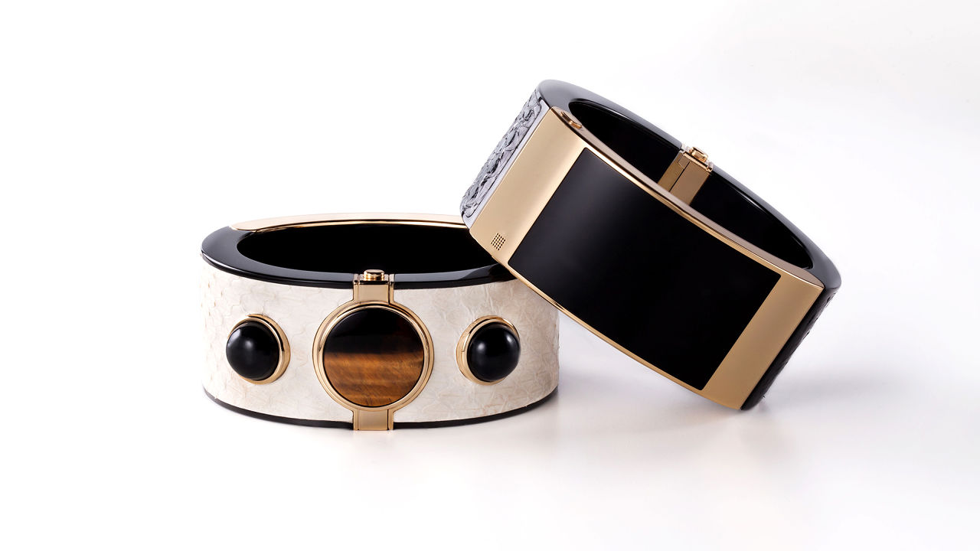
MICA (1 of 2)

Slide 77
MICA (2 of 2)
My Intelligent Communication Accessory [MICA], will be carried at select Barney's and Opening Ceremony stores in time for the holiday season.
This is an Intel/Opening Ceremony product
No real details/not a fitness monitor (at this time)
http://www.fastcompany.com/3035079/internet-of-things/opening-ceremony-takes-wraps-off-intel-powered-smart-bracelet?partner=rss

Slide 78
Stylish wearables (1 of 2)
Fitbit, other wearable fitness monitoring , and wearable technology companies are working on making their products more fashionable
Fitbit/Tory Burch
Google Glass/Diane von Furstenberg
Silicon Valley companies were everywhere at NY’s Fall 2014 fashion week

Slide 79
Stylish wearables (2 of 2)
Ralph Lauren has a sports shirt, with knitted-in sensors that can read the wearer's heartbeat and respiration.
Look like a fitted black crew-neck shirt. Upon close inspection, a band of thicker fabric mid-torso is apparent, and it houses a Bluetooth transmitter, an accelerometer, and a gyroscope by OMSignal, a biometric-tracker company.
http://www.slate.com/blogs/moneybox/2014/09/05/wearable_technology_companies_partner_with_fashion_labels_at_new_york_fashion.html

Slide 80
Vancouver scene
http://www.straight.com/life/729586/wearable-technology-sets-sail-vancouver

Slide 81
Allan Noordvyk & McKesson
Lung Cancer Screening Debate Continues to Draw Breath
http://www.medicalimagingtalk.com/4360/lung-cancer-screening-debate-continues-to-draw-breath/

Slide 82
Segue to Week 4: electronic skin and breast cancer detection
Men and women experience breast cancer
Sept. 10, 2014 researcher at University of Nebraska announced an electronic skin that can detect lumps in breasts
Humans can’t detect a breast lump until it’s about 21 mm (4/5 of an inch) across
This e-skin could detect lumps 5 mm across and at a depth of 20 mm

Slide 83
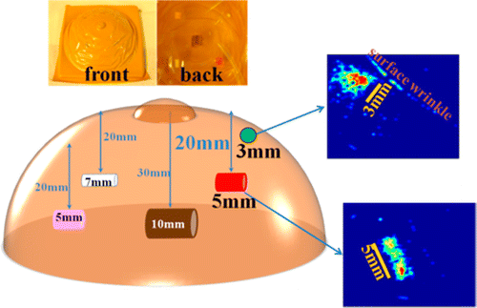
Electronic skin and breast cancer detection image (1 of 2)

Slide 84
Electronic skin and breast cancer detection image (2 of 2)
Using a silicone model of a breast and embedding objects representing lumps, scientists have successfully tested an electronic skin that can accurately “feel” and image lumps much smaller than those detectable by manual exams.
Credit: American Chemical Society

Slide 85
The e-skin: technical details (1 of 2)
The research team built the tactile device layer-by-layer using spin coating of polymers in combination with the deposition of 10-nanometer (nm) gold nanoparticles, which are often used in cancer detection and treatment techniques—along with 3-nm cadmium sulfide nanoparticles.)

Slide 86
The e-skin: technical details (2 of 2)
The overall multilayer structure consisted of three layers of gold nanoparticles and two layers of cadmium sulfide nanoparticles separated by nine layers of the polymers. All of this was then deposited onto a indium-tin oxide (ITO) glass substrate. The ITO served as the bottom electrode while aluminum foil was used as the top electrode. (http://spectrum.ieee.org/nanoclast/biomedical/diagnostics/electronic-skin-made-from-nanoparticles-offers-early-breast-cancer-detection

Slide 87
Electronic skin and breast cancer detection benefits
Mammography can be inadequate, especially for younger women
MRIs are expensive, this apparently is not

